Slide 1
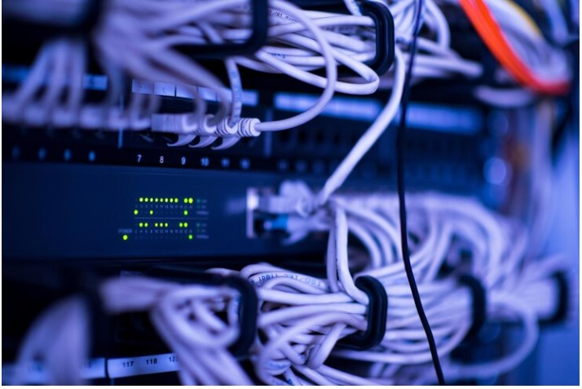
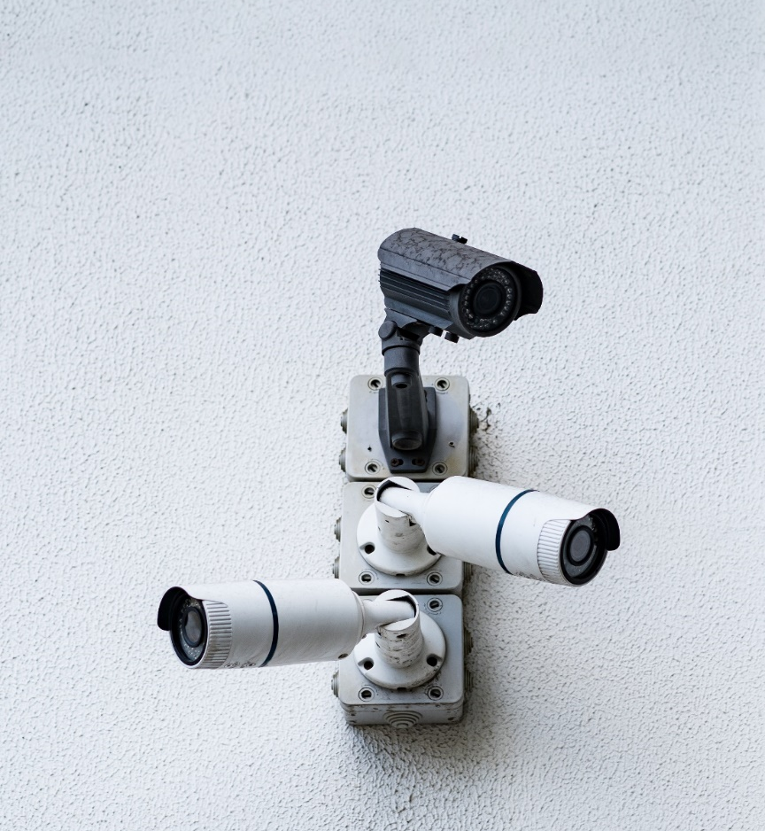
EKITI STATE UNIVERSITY PRESENTATION ON EXPERIENCED GAINED DURING SIWES.
NAME : ABANA JOSHUA SEGUN
MATRIC NO: 1909007001
FACULTY OF EDUCATION
COMPUTER SCIENCE

Slide 2
ABOUT THE COMPANY
ADC Systems Integrated Solutions is a leading provider of cutting-edge security solutions and smart technology installations. With a commitment to enhancing safety, security, and efficiency, we offer a wide range of services for both residential and commercial clients.
Services
CCTV Surveillance: We design, install, and maintain state-of-the-art CCTV camera systems that provide real-time monitoring and recording capabilities, ensuring the highest level of security.
Access Control: Our access control systems allow clients to manage and restrict entry to their premises, protecting against unauthorized access.
Fire Alarm Systems: Our fire alarm solutions are designed to provide early detection and immediate alerts in case of a fire emergency.
Smart Technology Installations:
Home Automation: We integrate smart home devices to enhance convenience and energy efficiency, allowing homeowners to control lighting, HVAC, and security systems remotely.
Office Automation: Our smart office solutions streamline workflow, improve productivity, and optimize energy usage through the installation of automation systems, including lighting, HVAC, and network management.
Networking Solutions: ADC Systems specializes in setting up robust networks, including switches, routers, and computers, to ensure seamless connectivity and data security.
Spyware and Monitoring: For both residential and commercial clients, we offer spyware and monitoring solutions to enhance security and surveillance capabilities.

Slide 3
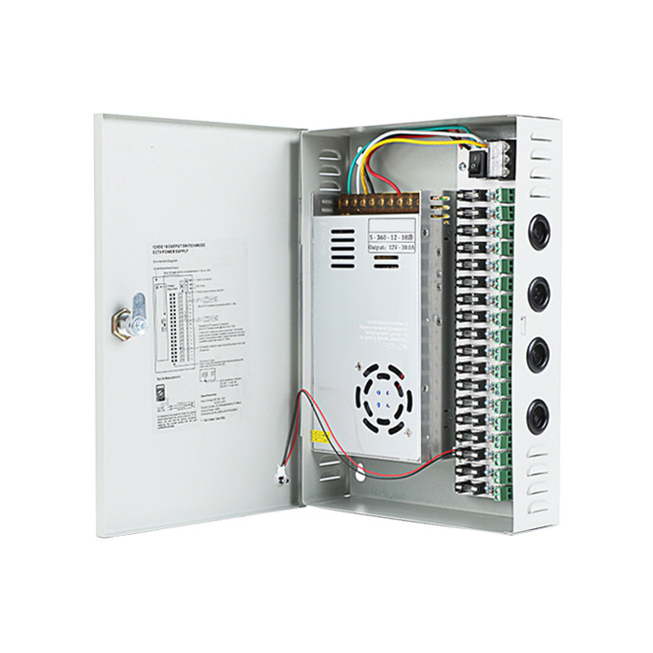
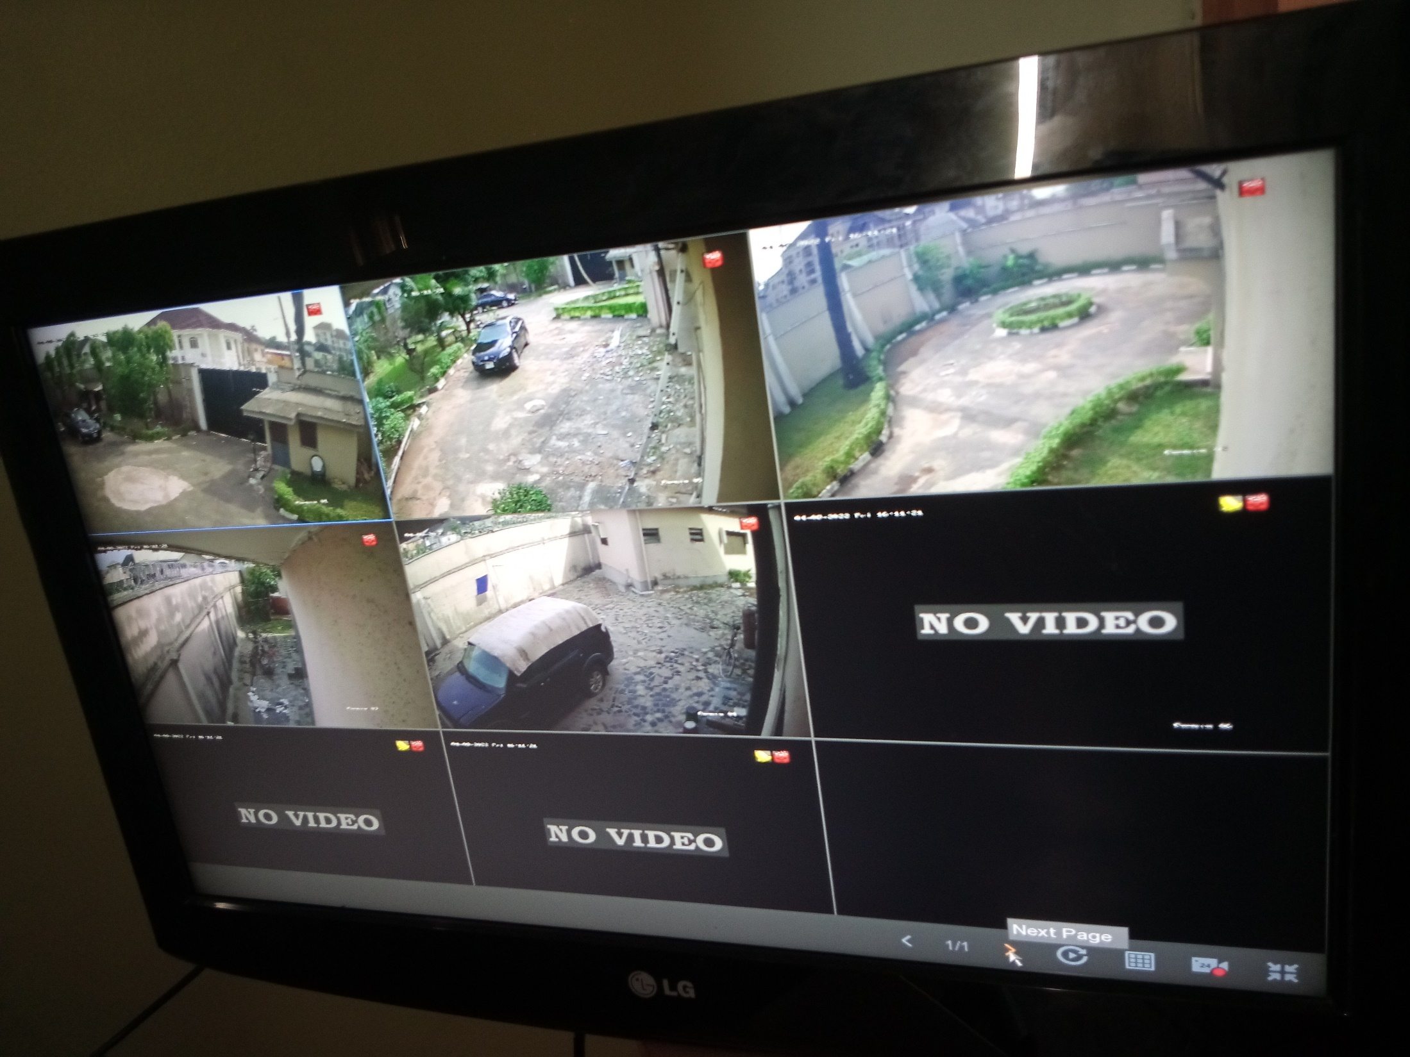
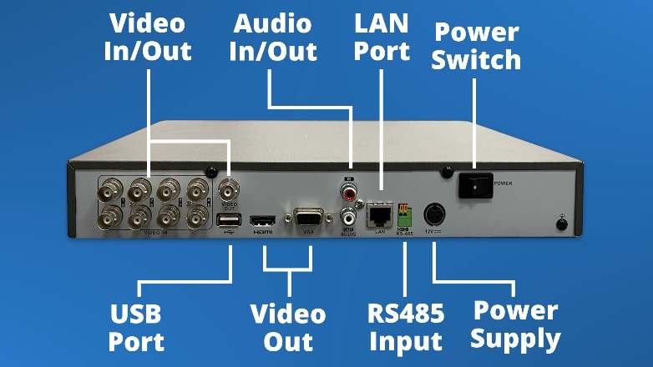
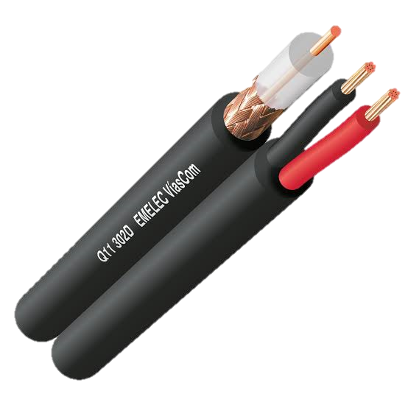
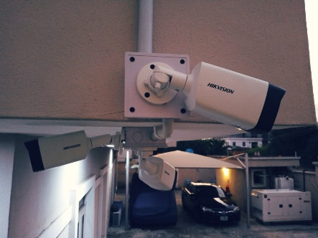
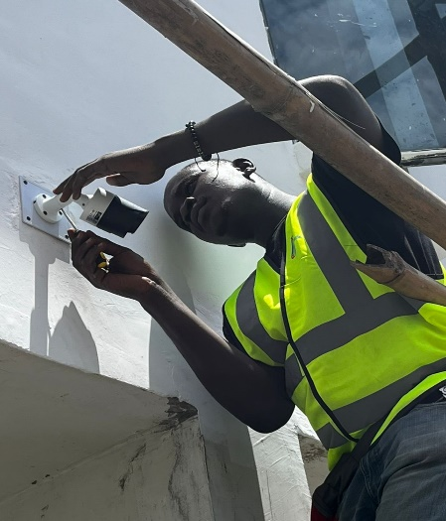
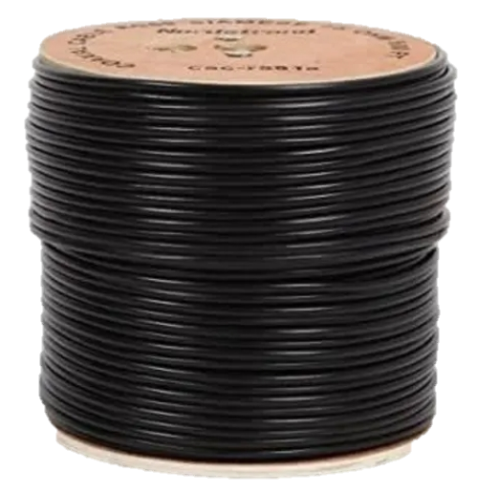
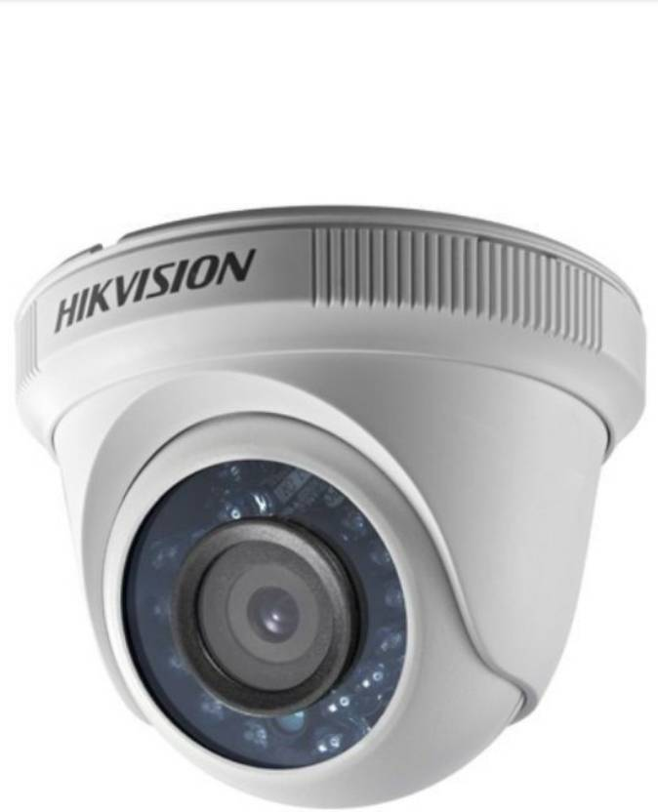
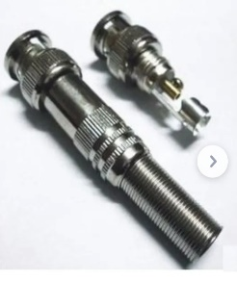
HD CCTV (High Definition CCTV)
HD CCTV often uses the same coaxial cables as analog systems, making it easier to upgrade existing infrastructure. However, some HD systems may use different types of cables for higher resolutions and longer distances.
HD systems uses DVRs
BNC CONNECTOR
HD CCTV systems offer higher resolution compared to standard analog systems. They can provide video in formats like 720p or 1080p, similar to HD television.

Slide 4
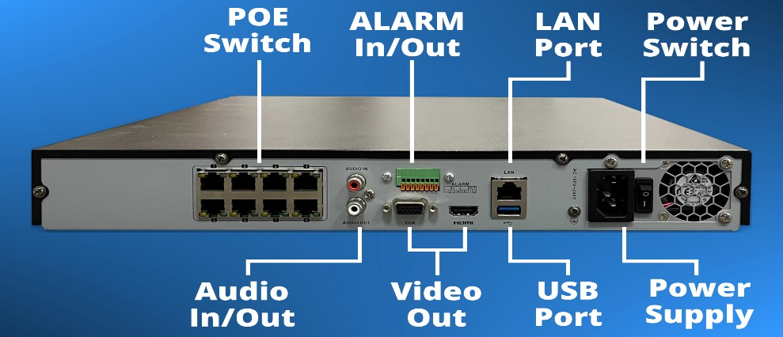
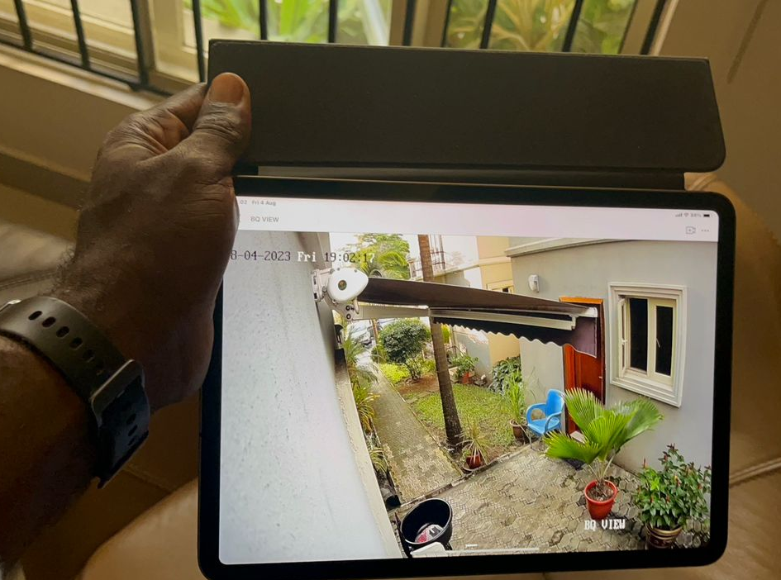
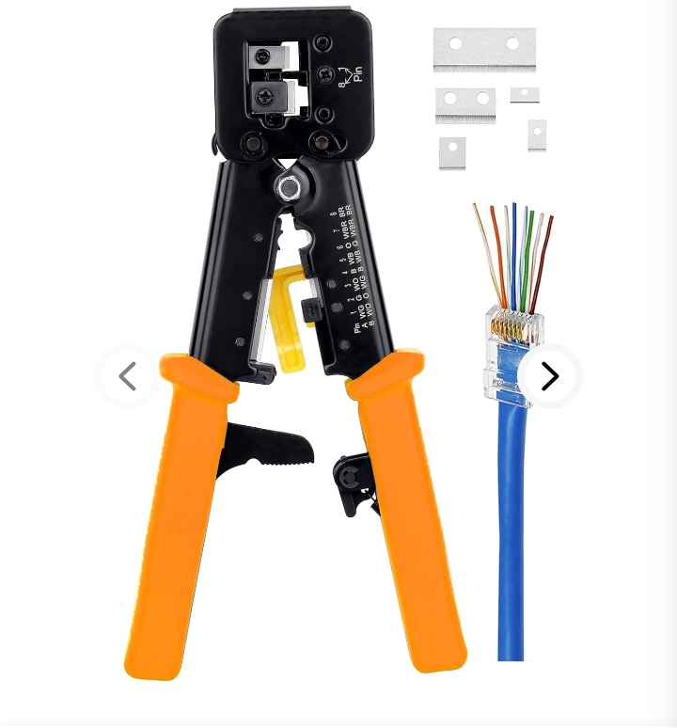

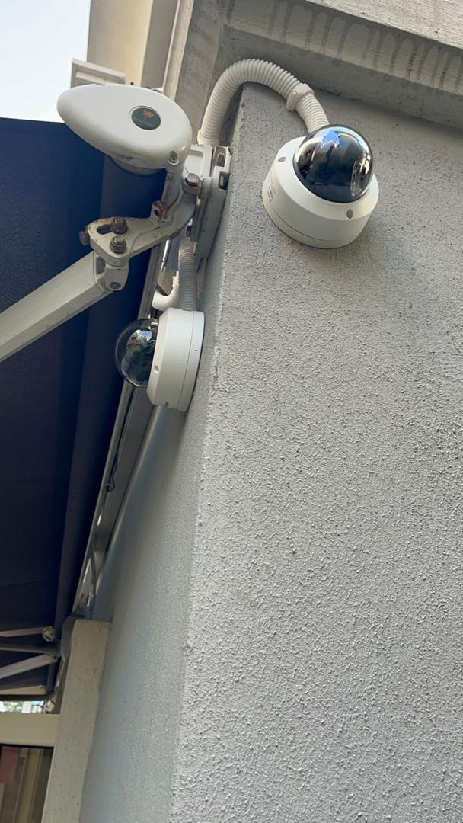
IP CCTV (Internet Protocol CCTV)
IP cameras use network cables (Cat 5e or Cat 6) to transmit video and other data. This allows for more flexibility and scalability in terms of installation and maintenance.
IP CCTV systems use NVRs to store video data. NVRs are connected to the network and can manage multiple cameras simultaneously. The storage capacity is typically more scalable and flexible compared to analog and HD systems.
IP cameras uses RJ45 Connector

Slide 5
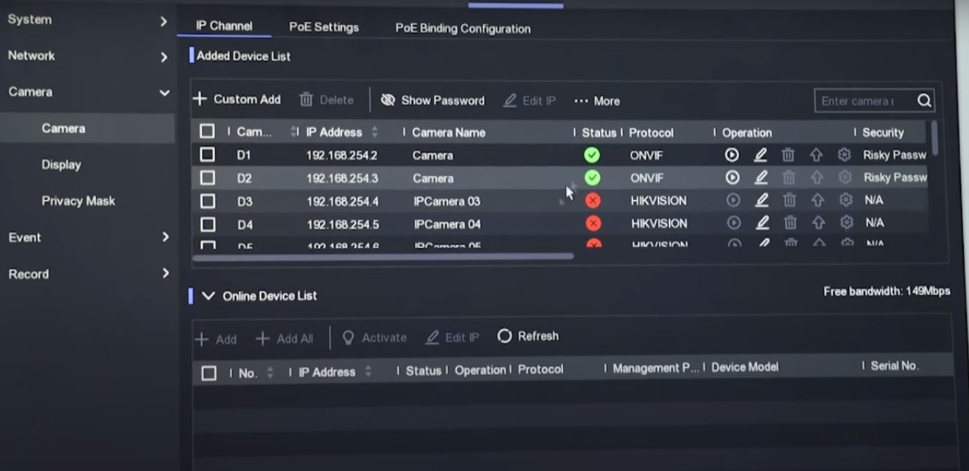
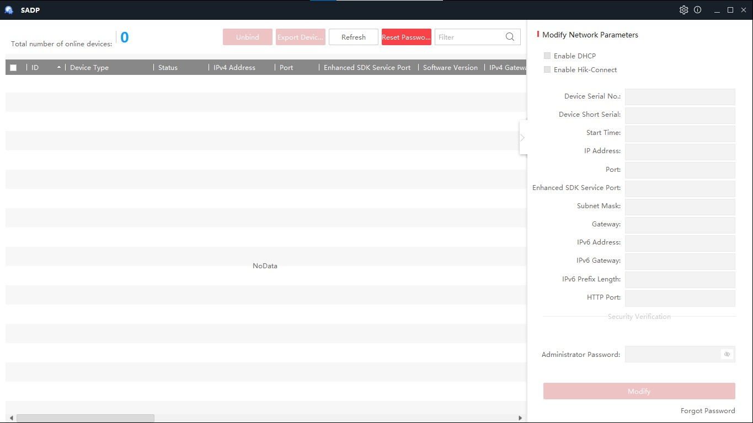

IP Configuration/Tools
SADP
(Search active
device protocol).
Enabling of DHCP

Slide 6
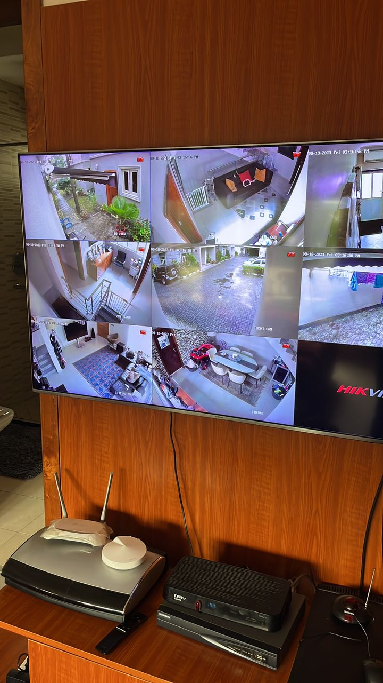
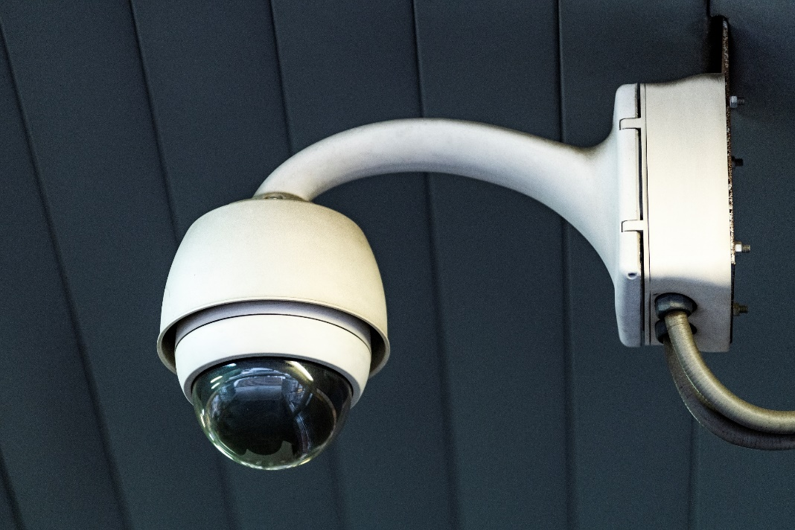
After configuration Result
After IP configuration and different troubleshooting, this is the result.

Slide 7
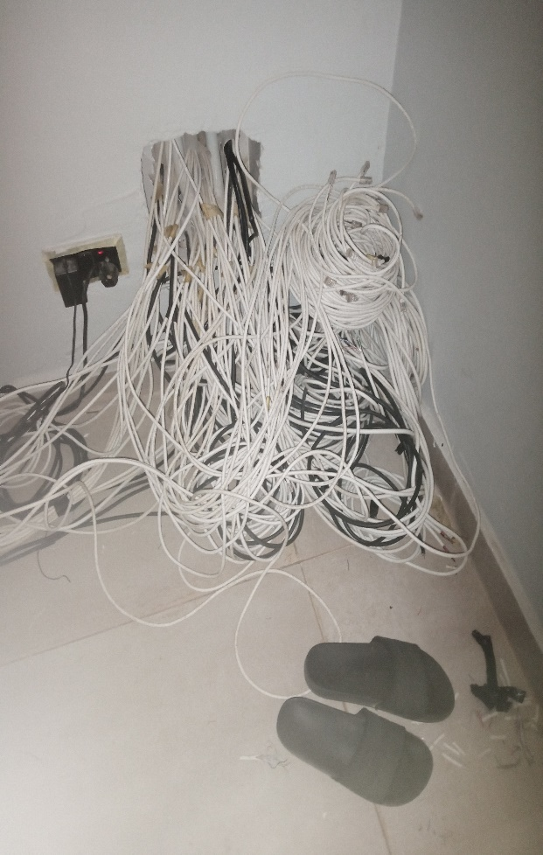
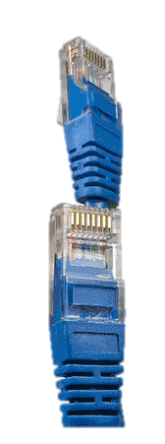
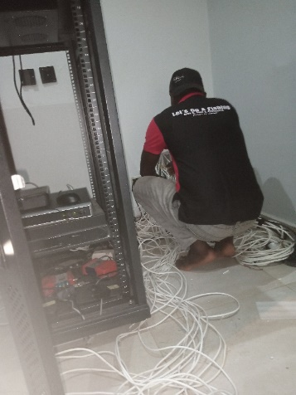
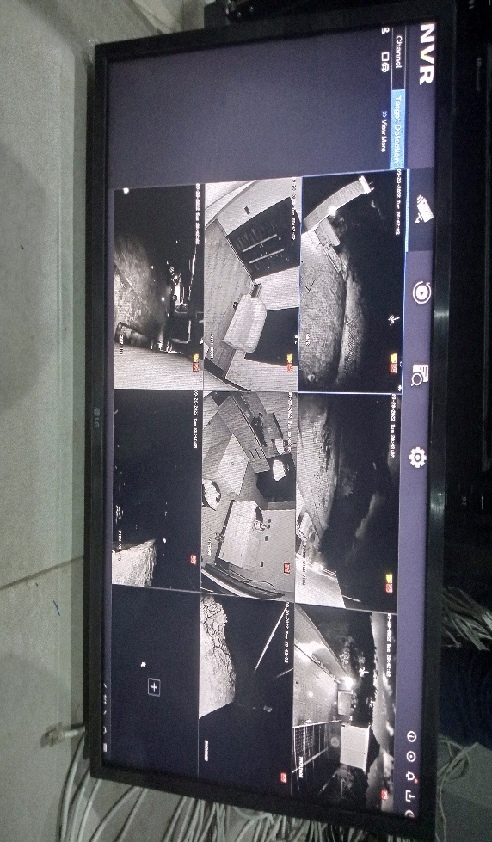
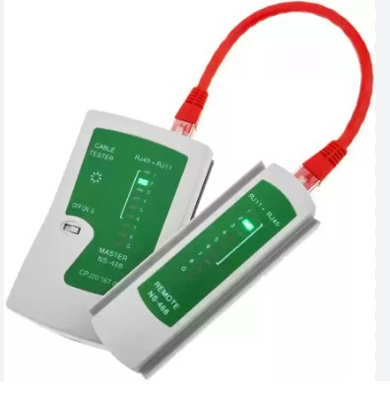
Experienced Gained
TROUBLESHOOTING OF NETWORK
CABLES FOR IP CAMERAS.
Cat6
Network
cable
Troubleshooting of network cables
For
IP (internet protocol) Cameras.
Result
We first had to troubleshoot all the network cables to figure out which is the camera cable
Rg6 cable
We used the straight through crimping method, after discovering all the network cables we configure the camera on the NVR.

Slide 8
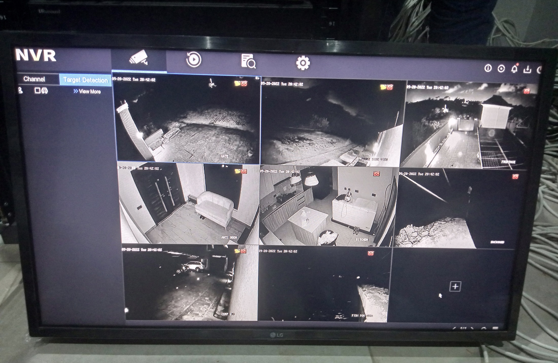
Clear result after configuration and troubleshooting

Slide 9
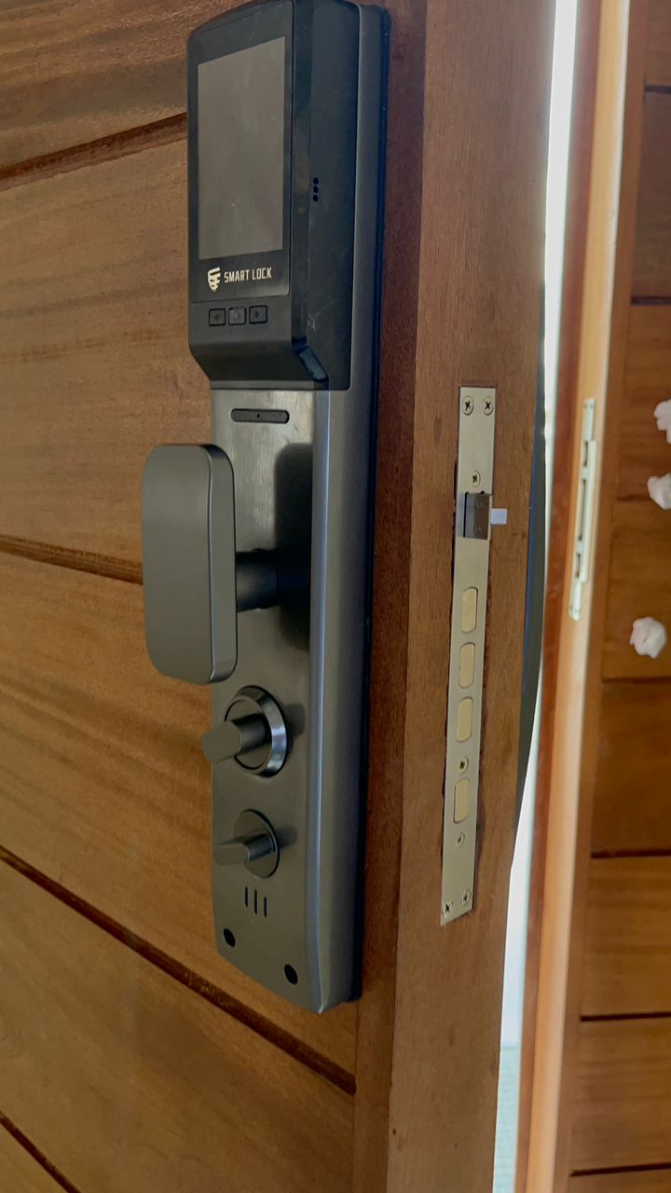
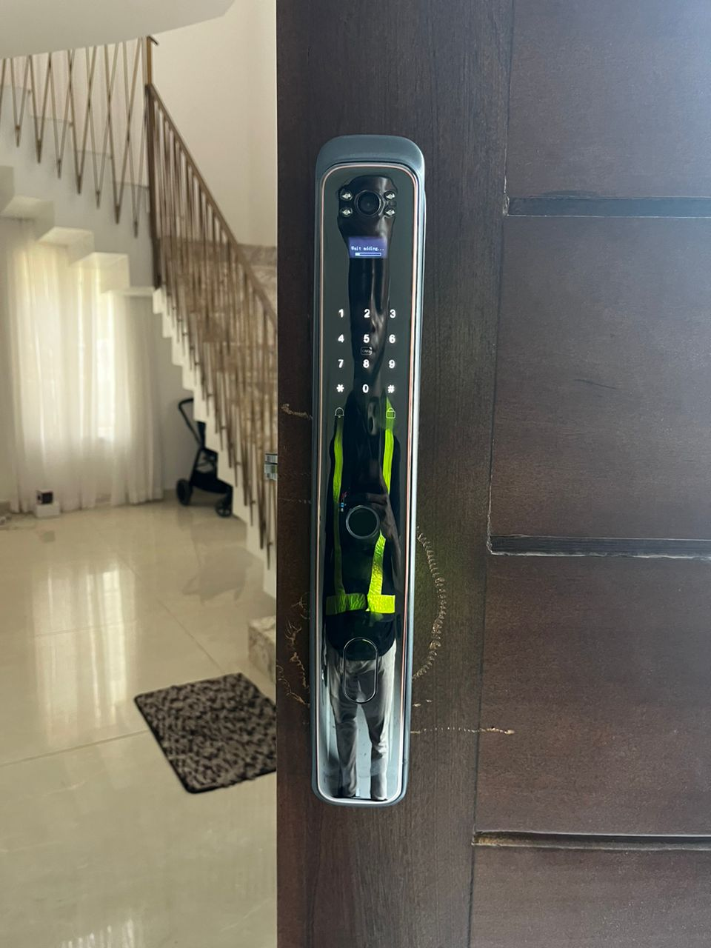
SMART LOCKS
Installation of smart locks with security functions like
Code, finger print, cards and a manual key.

Slide 10

THANKS FOR WATCHING!

